Slide 1
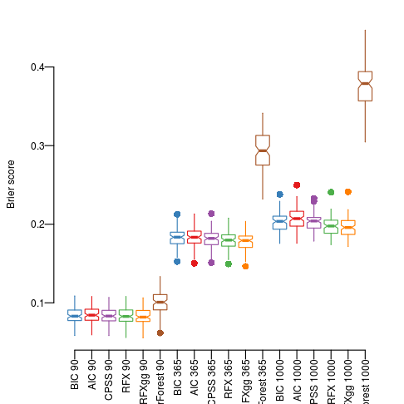
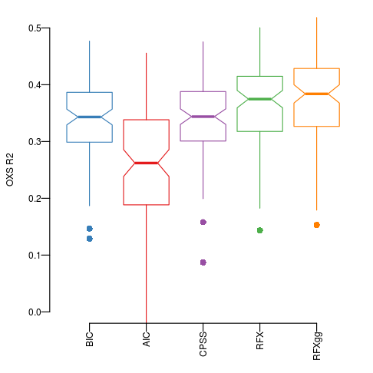
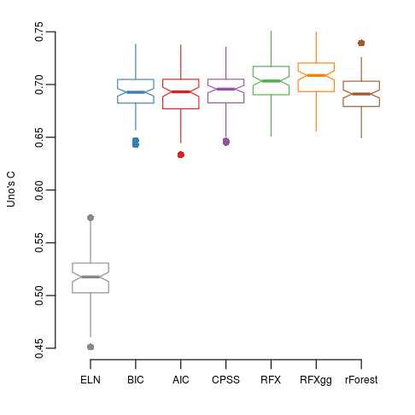
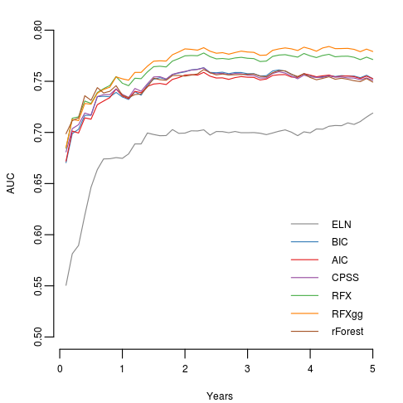
a
b
c
d
Supplementary Figure S1 Additional metrics for prognostic accuracy. a) Brier score. b) Generalised R² estimate of explained variation. c) Uno’s concordance estimate. d) Time-dependent area under the receiver operating characteristic curve AUC. Values shows are for 100 random cross-validation splits.

Slide 2
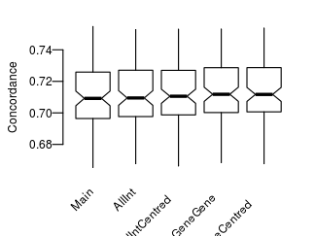
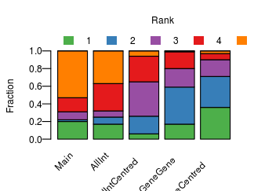
a
b
Supplementary Figure S2 Evaluation of random effects models with additional interaction terms. Main = main effects only. AllInt = interaction terms for all variable categories. AllIntCentred = interaction terms for all variable types with mean fixed at 0. GeneGene: Gene:gene interaction terms only. GeneGeneCentred: gene:gene interaction terms with mean 0. a) Concordance for 100 random cross-validation splits. b) ranks of the different model in each split

Slide 3
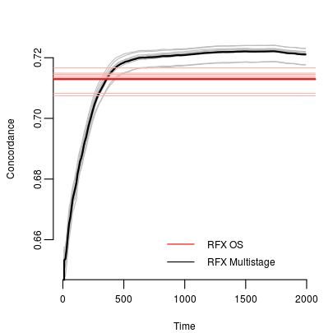
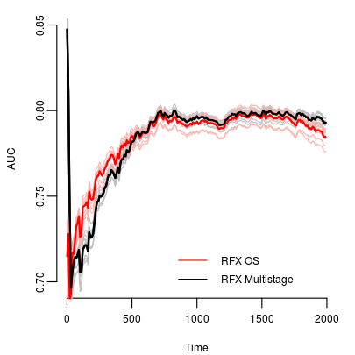
a
b
Supplementary Figure S3 Accuracy of multistage predictions. a) concordance as a function of time (days after diagnosis). b) corresponding AUC. Data shown are for 10 10-fold cross-validation splits, each training splitting the data into 1/10ths, training the model on all possible 9/10 and evaluating on the remaining 1/10.

Slide 4
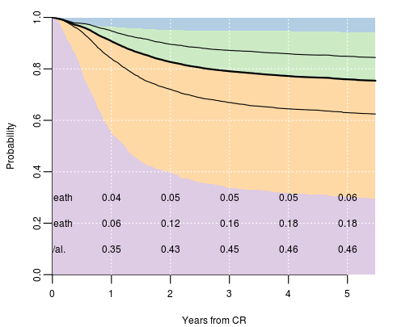
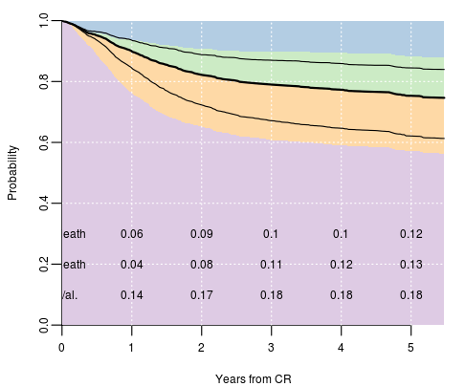
a
Standard chemo with allograft after relapse
b
Allograft in CR1
Supplementary Figure S4 Predicted outcome in a patient in PD11080, a 32yr old female with mutations in EZH2 and t(6;9), which would be commonly associated with poor risk.

Slide 5
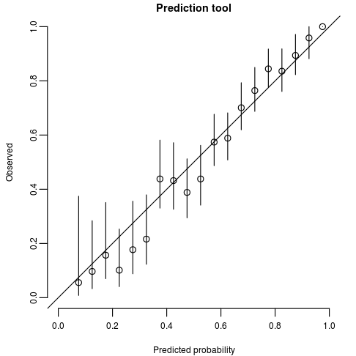
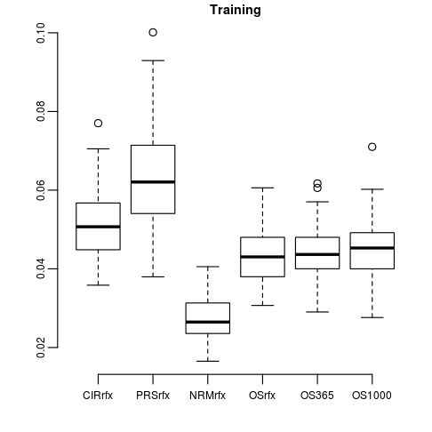
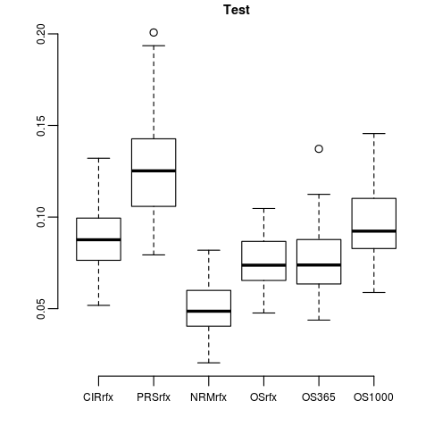
Supplementary Figure S5 Accuracy of absolute risk predictions a. In-sample errors for the multistage model b. Training errors for different stages. CIR: Relapses; PRS: Post-relapse survival; NRM: Non-relapse mortality; compared to OS: rfx regression on survival ;OS365: multistage prediction at 365 days; OS1000 multistage prediction at 1000 days. Distributions are shown for 100 random test/training splits 20:80. c. Test errors, labels as in part b.

Slide 6
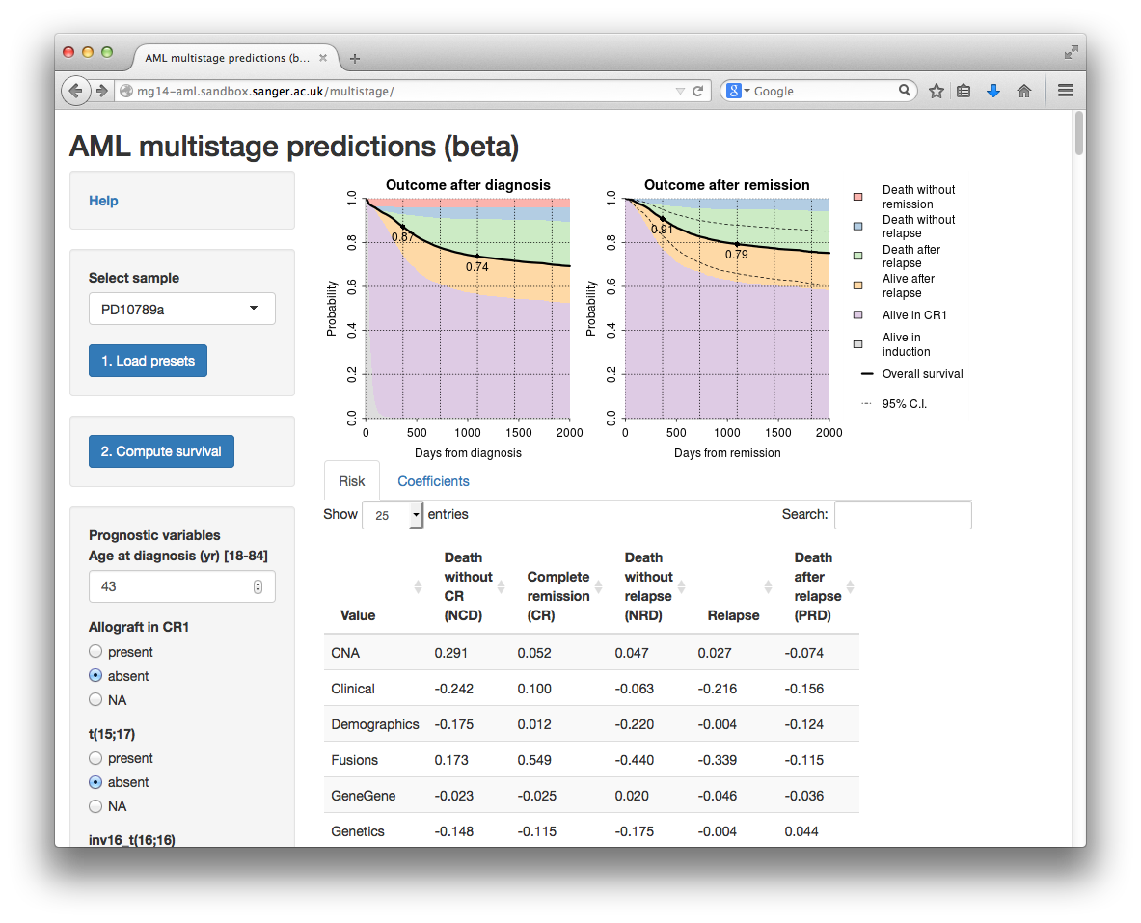
Supplementary Figure S6 Screenshot of the webserver, available at http://mg14-aml.sandbox.sanger.ac.uk/multisite

Slide 7
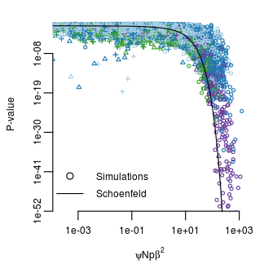
Supplementary Figure S7 Distribution of P-values (y-axis) in comprehensive simulations using 100 (+), 1000 (Δ), and 10000 simulated patients (o), respectively. P-values are shown as a function of the product of N (sample size) ψ (uncensored fraction) p (mutation frequency) and β² (squared log hazard) as indicated on the x-axis. The solid lined indicates an analytical approximation by Schoenfeld, described in Schmoor (2000).

